Slide 1
Information Technology Committee
July 27, 2023

Slide 2
New Projects Approved by CIO
Requiring Ratification from the ITC
VCFMS – Adv4 Upgrade and Cloud Transition– Auditor Controller’s Office
Regional Radio Project – Information Technology Services Department

Slide 3
VCFMS Adv4 Upgrade and Cloud Transition
Agency: Auditor-Controller’s Office
Description: Upgrade of the County’s financial system to the latest version of software, move its operational platform to the Cloud, and transition current reporting system solution.
Project Goal: Transition the County’s financial system to the cloud, upgrade it to the latest version, and provide an enhanced reporting solution.
One Time Implementation Costs: $5,690,200
Total 5 Year Cost: $10,992,600
Projected Benefit: Move County to latest version of software while providing access to a wider operational and technical resource pool for support, system security, and disaster recovery.
Project Duration: 12 months
Notes:
15 cameras
LPR licenses

Slide 4
REGIONAL RADIO SYSTEM – 700 MHz
Agency: Information Technology Services
Description: A new Public Safety Radio System
Project Goal: Replace the current VHF Public Radio System used by Sheriff
– add outside Public Safety Agencies for interoperable communication
One Time Implementation Costs: $36M
Total 5 Year Cost: $29M
Projected Benefit: Improved Digital Communications
Project Duration: 5 Years
Notes:
15 cameras
LPR licenses

Slide 5
CURRENT STATUS
Board of Supervisors approved Motorola Contract
Sherriff's Office is fully committed to the project
Cities of Oxnard and Ventura Police Departments are very interested and are contributing to the MOU
Fire will join the system at a future date

Slide 6
Projects for Review /Approval by The ITC
VCMC Medical-Grade Network – Health Care Agency

Slide 7
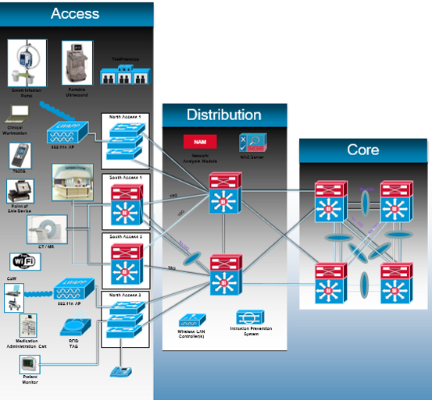
HCA Medical Grade Network
Agency: Health Care Agency
Description: Replacing the aging network infrastructure within the medical system
Project Goal: Implementation of a Medical Grade Network to support the mission critical medical system
One Time Implementation Costs: $10,591,049 ($7,761,442 year 1 and $2,829,607 year 2, including 10% contingency)
Total 5 Year Cost: $12,044,598
Projected Benefit: Revenue, Cost Savings, Cost Avoidance, Compliance
Project Duration: 18-24 months
Notes:
15 cameras
LPR licenses

Slide 8
Healthcare Requirements and Trends
Data, Voice, Video Integration with Clinical Systems
Data – High bandwidth for 3D, 4D, 4K Imaging and Video
Video Services
Telehealth, Virtual & Mobile Care, Video Remote Interpreting
Surgical Compliance & Training, Patient Education, Video Surveillance
Healthcare technologies and Biomedical systems integration and convergence
Nurse Call, Telemetry, Patient Monitoring, Clinical Imaging, Drug Dispensing
IoMT, Wearables, Remote Patient Care/Monitor
Telehealth, Virtual Care
Real Time Location based tracking (RTLS)
Digital Front Door
Patient Education and Entertainment
Building Management systems integration
Artificial Intelligent
Healthcare IT Infrastructure Requirements
Designed to support the business of Healthcare.
Designed for critical applications and technologies that support patient care
Redundancy and fault tolerance
Network uptime – 99.999% - Internally and Externally
Local survivability in the event of network failure
High performance
From the end devices to applications – either internally or externally
Scalable and Flexible
Ability to quickly scale as new services become integrated into network
Flexible to support technical innovations in healthcare and to adapt quickly to support new technologies
Security
From physical security to multiple layers of IT – HIPAA compliance
Segmentation from non-healthcare network to protect PHI
Secure Biomedical devices and IoMT
Secure remote access for staff and vendor
Real Time Monitoring and Management
Real time monitoring of all systems for faults and proactive analysis
Operational Support – 24x7 real time support

Slide 9
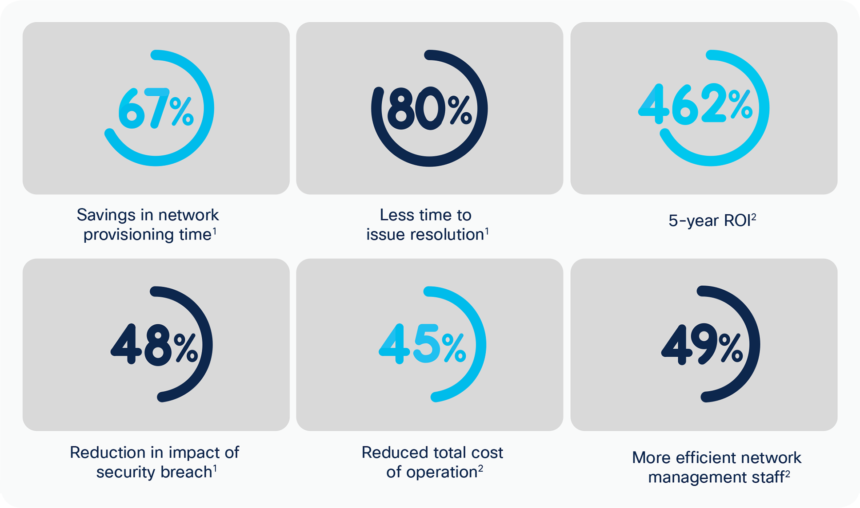
Traditional Network
Cisco DNA with Software Defined Access (SDA)

Slide 10
Adjourn
Thank you for your time.

