Slide 1
Roads & Transportation
Santa Rosa Valley MAC Meeting
March 20, 2025
Notes:
Here are notes for this slide

Slide 2
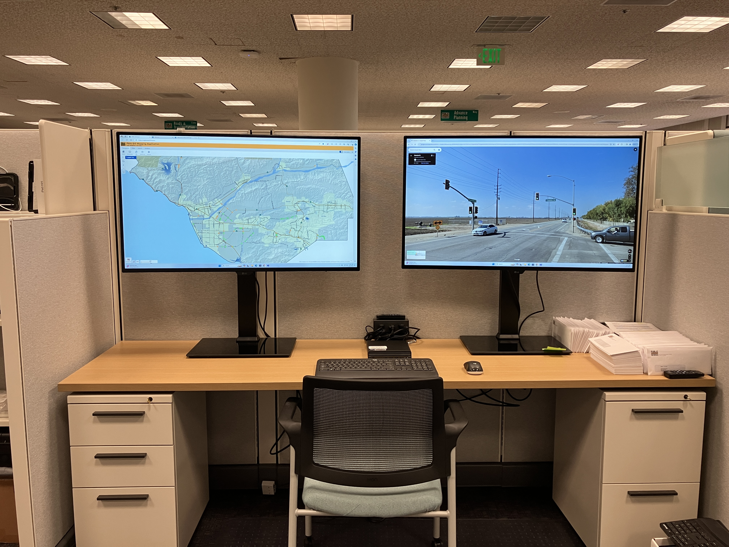
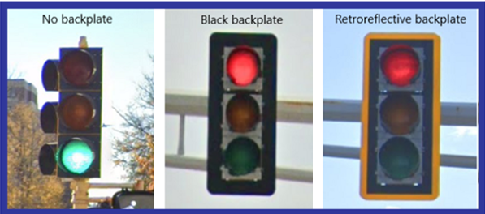

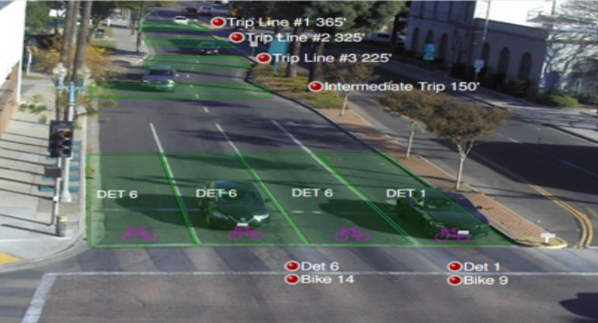
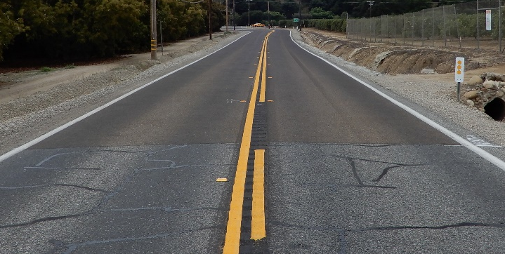
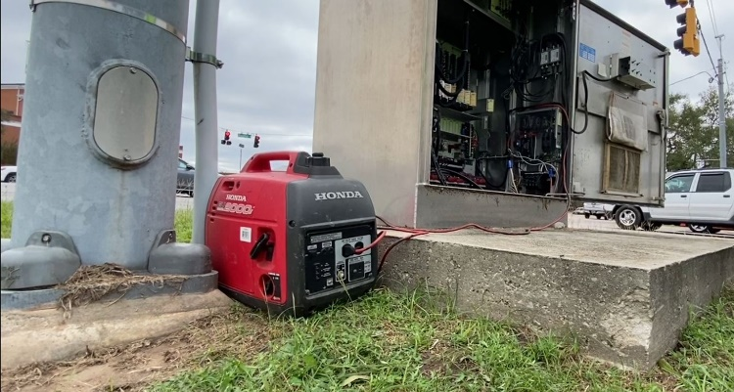
Systemic Signal Improvement Project
Add retroreflective backplates
to all signal heads
New signal controllers
Traffic Management Center
Dilemma Zone Detection Cameras and High friction surface treatment
At the E. Las Posas Road and the Moorpark Road intersections
Backup power for signals

Slide 3
Systemic Signal Improvement Project Schedule for Santa Rosa Valley
New Controllers have been installed
Video detection cameras at Moorpark Rd and Las Posas Road installed this week.
Mill & fill + Temporary striping at Moorpark and Las Posas
High Friction Surface Treatment at Moorpark Road & Santa Rosa and at Las Posas Road & Santa Rosa, 1 day each, mid to late May
Striping restoration, 1 day
Backplates and Signal Heads, half-day at each intersection planned for early May
Anticipated project completion June 2025

Slide 4
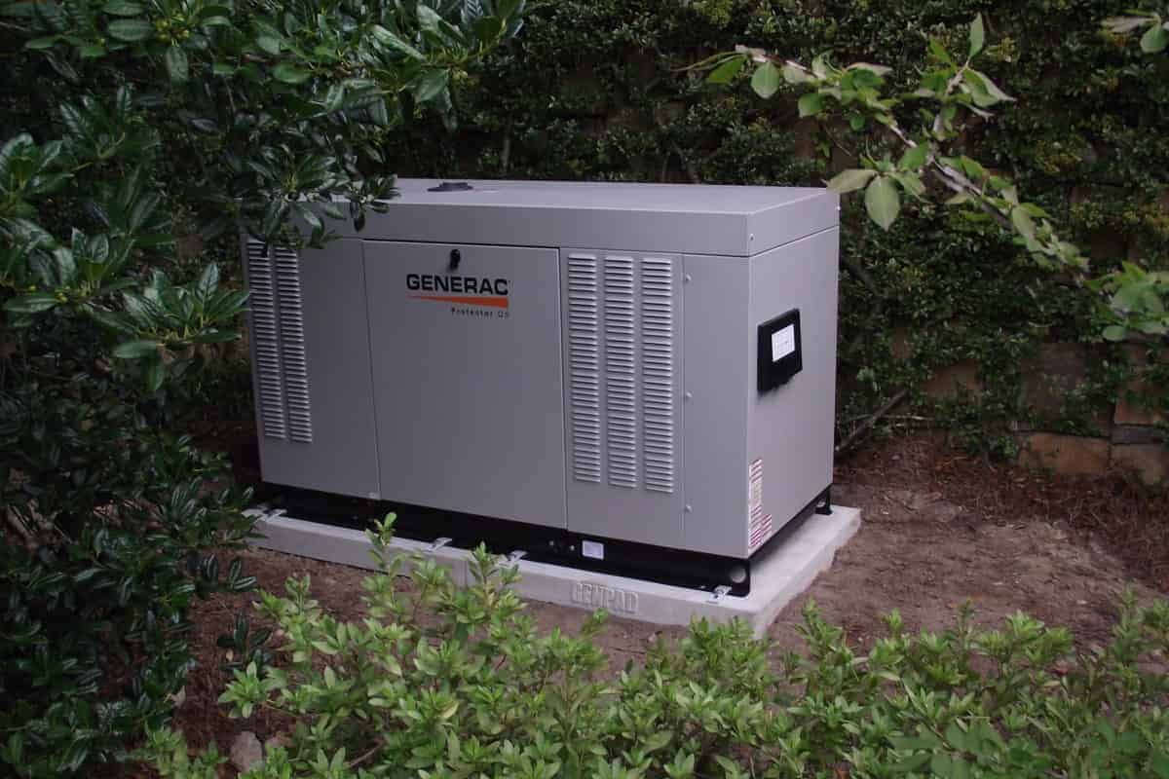
Backup Power for Public Safety Power Shutoff Events
Portable Gasoline Generators
  Pros:
    Inexpensive
    Relatively quiet
  Cons:
    Manually deployed
    Need refueling every 4 hours
    Produce Emissions
    High probability of theft
Pad Mounted Gas or Diesel Generators
  Pros:
    Generally larger fuel capacity
    Less susceptible to theft
    Automatically turned on with power loss
  Cons:
    Produce Emissions
    Need refueling every 8 to 12 hours

Slide 5
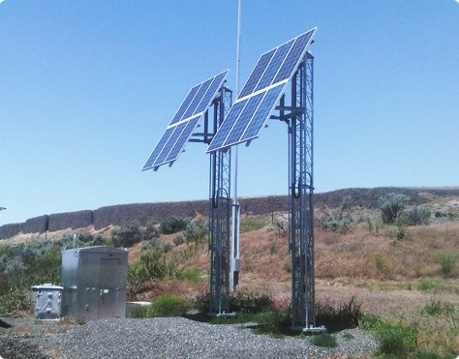
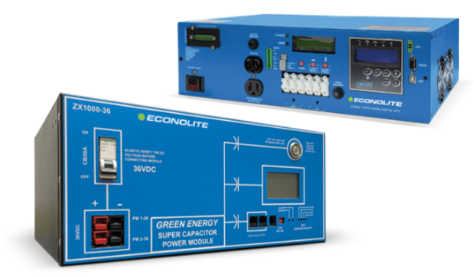
Backup Power for Public Safety Power Shutoff Events
Solar Power
  Pros:
    No emissions or noise
  Cons:
    Power generation dependent on fair weather
    Solar array can be large
Super Capacitor (like a battery)
  Pros:
    About 10 hour run time
  Cons:
    Not effective for extended PSPS events
Notes:
Total 114 ( 78 + 36)

Slide 6
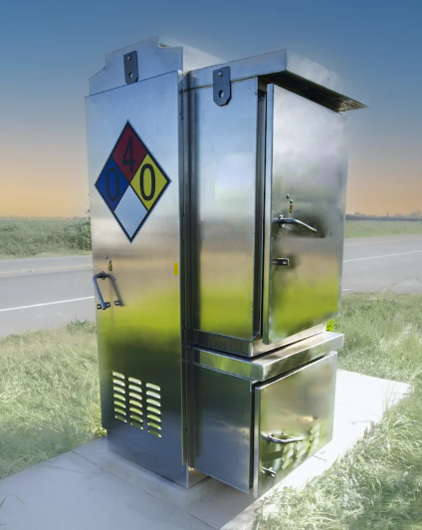
Backup Power for Public Safety Power Shutoff Events
Hydrogen Fuel Cell
  Pros:
    Can provide 5+ days of power
    No noise
    Clean water vapor emissions
  Cons:
    Hydrogen gas cylinders
Notes:
Total 114 ( 78 + 36)

Slide 7
In Progress/Upcoming Projects
Adaptive Corridor Study
  This study is currently being conducted by a consultant to determine if several signalized corridors are compatible with an Adaptive Corridor design, including Santa Rosa Road
Update the 2019 Traffic and Timing Study for the Santa Rosa Road / Moorpark Road intersection along with the Gap Study for the rest of the corridor
  Increased delays reported on Moorpark Road approaching Santa Rosa Road
Notes:
Total 114 ( 78 + 36)

Slide 8
Questions?

