Slide 1


Understanding Your Flexible Spending Account
What Is an FSA?
Why Would I Want an FSA?
How Would I Use an FSA?
What Are the Resources Available?

Slide 2




What is a Flexible Spending Account?
A Flexible Spending Account (FSA) is a type of account, provided by your employer, that allows you to put aside money to pay for eligible healthcare and dependent daycare expenses.
A flexible spending account is a great idea because by having this account, you can save money on items and services you are already spending money on!
Great Idea
1000’s of Eligible Items and Services
Less Taxes

Slide 3
Why Would I Want a Flexible Spending Account?
By enrolling in a flexible spending account, you may save up to 40% on your healthcare and dependent daycare costs.
The money going into the account is tax-free (no payroll tax is withheld) which can save you money on items and services you are already purchasing.
The following chart shows a comparison of an employee with an FSA and one without an FSA.
FSA? | Monthly Pay | Pre-tax FSA Contribution | Taxable Income | Minus Taxes | After Tax $ Spent | Spendable Income | Monthly Tax Savings
With an FSA | $2,000 | $100 | $1,900 | -$571 | -$0 | $1,329 | $30
Without and FSA | $2,000 | $0 | $2,000 | -$601 | -$100 | $1,299 | $0
Annual Tax Savings = $360
Check out the Tax-Savings Calculator at www.chard-snyder.com / Support Center / Tools and Apps

Slide 4
How Would I Use a Healthcare FSA?
A healthcare FSA is designated for eligible medical expenses such as copays, coinsurance, deductibles along with things like prescriptions, medical supplies and procedures.
Since the IRS is allowing you to put money in your FSA before it is taxed, they determine how much you can contribute and what expenses are eligible for reimbursement from the account.
You can elect up to $2,749.92 and use for things like:
Co-Insurance
Menstrual Hygiene
Products*
Prescriptions
Deductibles
Over-the-Counter Meds*
Hospital Services
Orthodontia
Expenses
For more resources on eligible expenses visit our website - www.chard-snyder.com
*Due to the CARES Act, signed on March 27, 2020, a prescription is no longer required to purchase over-the-counter medications using FSA funds. Menstrual hygiene products were also made eligible with the CARES Act.

Slide 5
How Would I Use a Dependent Daycare FSA?
A dependent daycare FSA is designated for expenses incurred to care for your children age 12 and younger, as well as your adult tax dependents who are unable to care for themselves, while you are at work.
Since the IRS is allowing you to put money in your FSA before it is taxed, they determine how much you can contribute and what expenses are eligible for reimbursement from the account.
You can elect up to $2,499.84 for Single and $4,999.92 for Family:
Child
Daycare
Nursery
School
Summer Day Camps
Senior
Daycare
After School Programs
For more resources on eligible expenses visit our website - www.chard-snyder.com

Slide 6
What is the FSA Grace Period?
The Grace Period allows another 2 ½ months after the plan year ends to spend your FSA funds.
Here is an example of how it works:
Last Year
$100 leftover
In your FSA
New Year
Enroll in FSA for $2500
Pay Bills (Submit Claims)
Pay dentist with $50 of last years money
Pay Urgent Care with $50 of last years money and $300 of new year’s money
$400 total
Visit to the Dentist
Cost $50
Visit to Urgent Care
Cost $350

Slide 7
Are There Any Rules When Using an FSA?
Yes. As mentioned before, since the IRS is allowing you to put money in your flexible spending account tax-free, they have a few rules you will need to be aware of.
1
2
3
4
You decide the amount you want to contribute before the plan year starts
You cannot change your contribution amount during the plan year*
You can only use the money for eligible expenses.
The IRS decides.
The money you spend cannot be claimed on your taxes later
*Qualifying Event

Slide 8
How Would I Use a Commuter Account?
A Mass Transit account is designated for eligible transit expenses such as bus fares, train fares, or subway fares you purchase to commute to work.
Since the IRS is allowing you to put money in your FSA before it is taxed, they determine how much you can contribute and what expenses are eligible for reimbursement from the account.
You can elect up to $270 per month and use for things like:
Ride the Ferry
Get on the Subway
Ride in a Vanpool
Take the Bus
Take the Trolley
Ride the Commuter Train
Vision
Internal Use Only

Slide 9
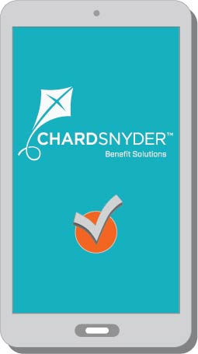
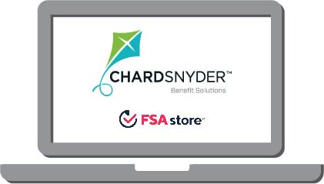

What Are the Resources Available?
Chard Snyder offers many resources to help you manage your FSA.
Once you enroll, you will have access to your Chard Snyder Online Account, the Chard Snyder mobile App, and a team of friendly custom service representatives.
Our mobile app even has a handy eligible item scanner so you know on the spot if an item is FSA-eligible for purchase.
Chard Snyder Website
www.chard-snyder.com
Chard Snyder
Customer Service
800.982.7715
Chard Snyder Mobile App
Visit the FSA Store and shop for FSA-eligible items. Use coupon code: CS10WEB1

Slide 10
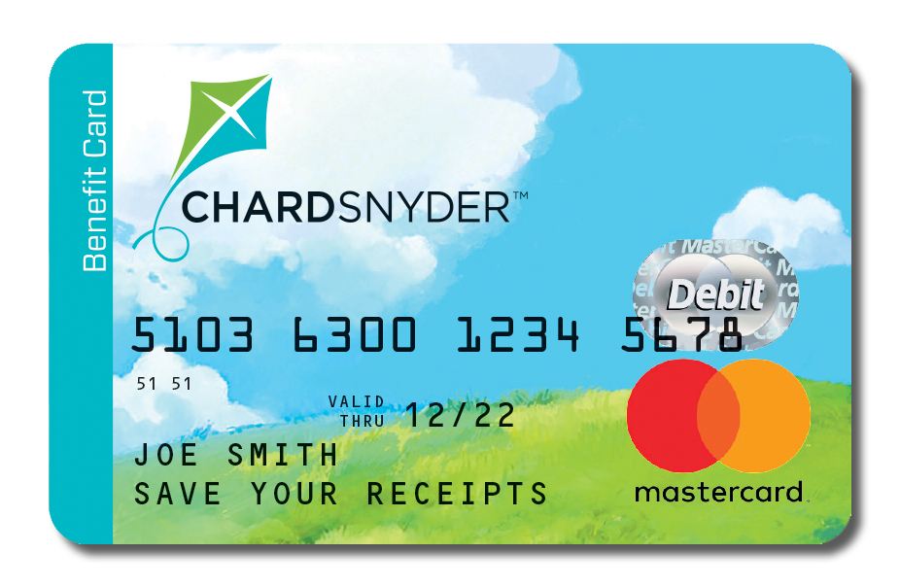
How Do I Access My FSA Funds?
You can always request a distribution by filing a claim, but the Chard Snyder Benefit Card provides an easy, simple way to use your FSA funds to pay for eligible items and services.
It works just like a debit card, but because of smart technology, it can only be used to pay for expenses that are eligible according to the IRS guidelines.
Only use for eligible expenses
Simple Way to Pay
Payment Directly from Account
Good for 5 years
Save Your Itemize Receipts!
The Benefit Card must be used to pay for mass transit expenses.

Slide 11

How Do I Access My FSA Funds?
If you forget to use your card? No problem!
You can always file a claim. Use our mobile app, online account or even fill out a paper claim and send to us. You will need to send in your itemized receipt(s) that include the following information:
☑ Date of Service
☑ Recipient’s Name
☑ Description of Service
☑ Provider Information
☑ Amount You Owe
Add direct deposit information to your online account and receive your reimbursements directly into your bank account.

Slide 12

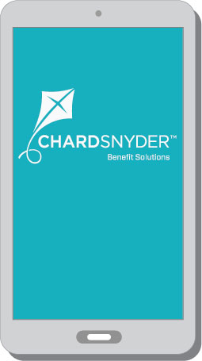
Is There an App for That?
Use the Chard Snyder Mobile App to manage your account on-the-go!
Features Include:
View account snapshot
View account activity and check your balance
Enter and track expenses
Submit FSA claims with receipt images using your phone’s camera
View claim status
Scan products for eligibility (Plan restrictions may apply)
Download for FREE from the App Store or Google Play.

Slide 13
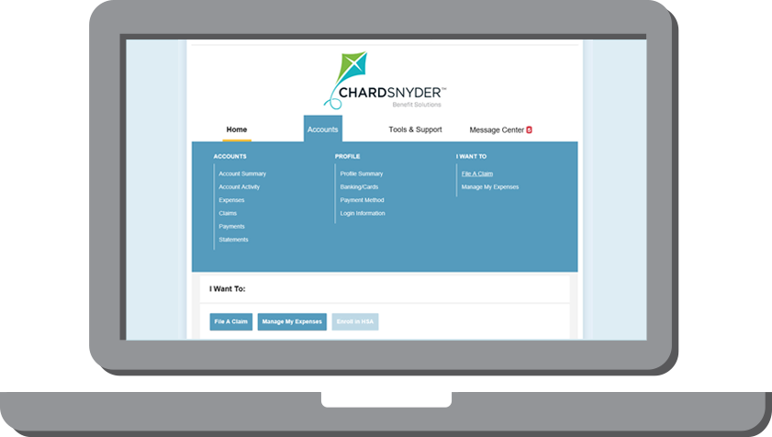
How Do I Access My Account?
Your Chard Snyder Online Account is available to you 24/7.
View up-to-the minute account balances
File a claim online
Upload receipts and track expenses
Sign up for Direct Deposit
View your account activity, claims history and payment history
Change your login ID and/or password
Download plan information, forms and notifications
Access a full list of eligible expenses

Slide 14

What’s Next?
So we’ve learned about the FSA and how this plan can benefit you. Now you will want to review your annual expenses so you know how much to set aside and … simply enroll!!!
Review Your Options
Review Your Expenses
ENROLL!
If you still need to do some figuring, check out the Tax Savings Calculator on our website – www.chard-snyder.com.

Slide 15


chard-snyder.com | 800.982.7715 | Find us on LinkedIn & Facebook

